Slide 1
Group : 2
Name | Id
RAHAMAN MD AKIB UR | 19-40279-1
DEB KABYO | 19-40242-1
DAS RAHUL | 19-40241-1
BISWAS PROSENJIT | 19-39637-1

Slide 2
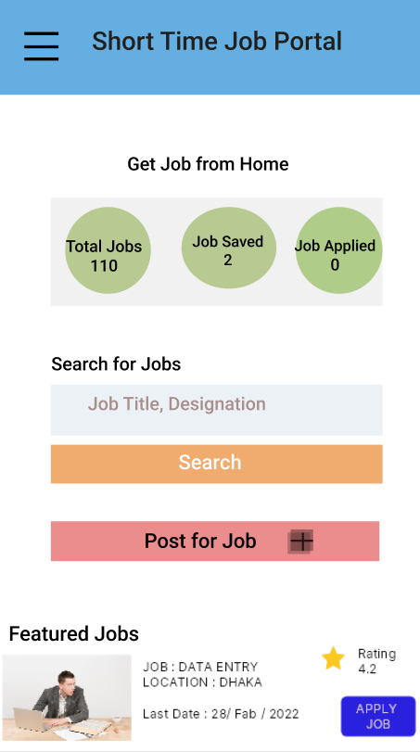

Slide 3
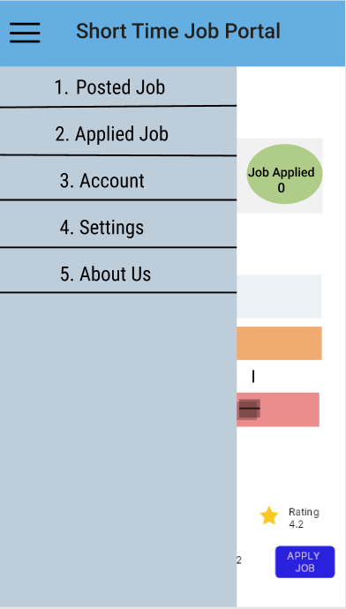

Slide 4
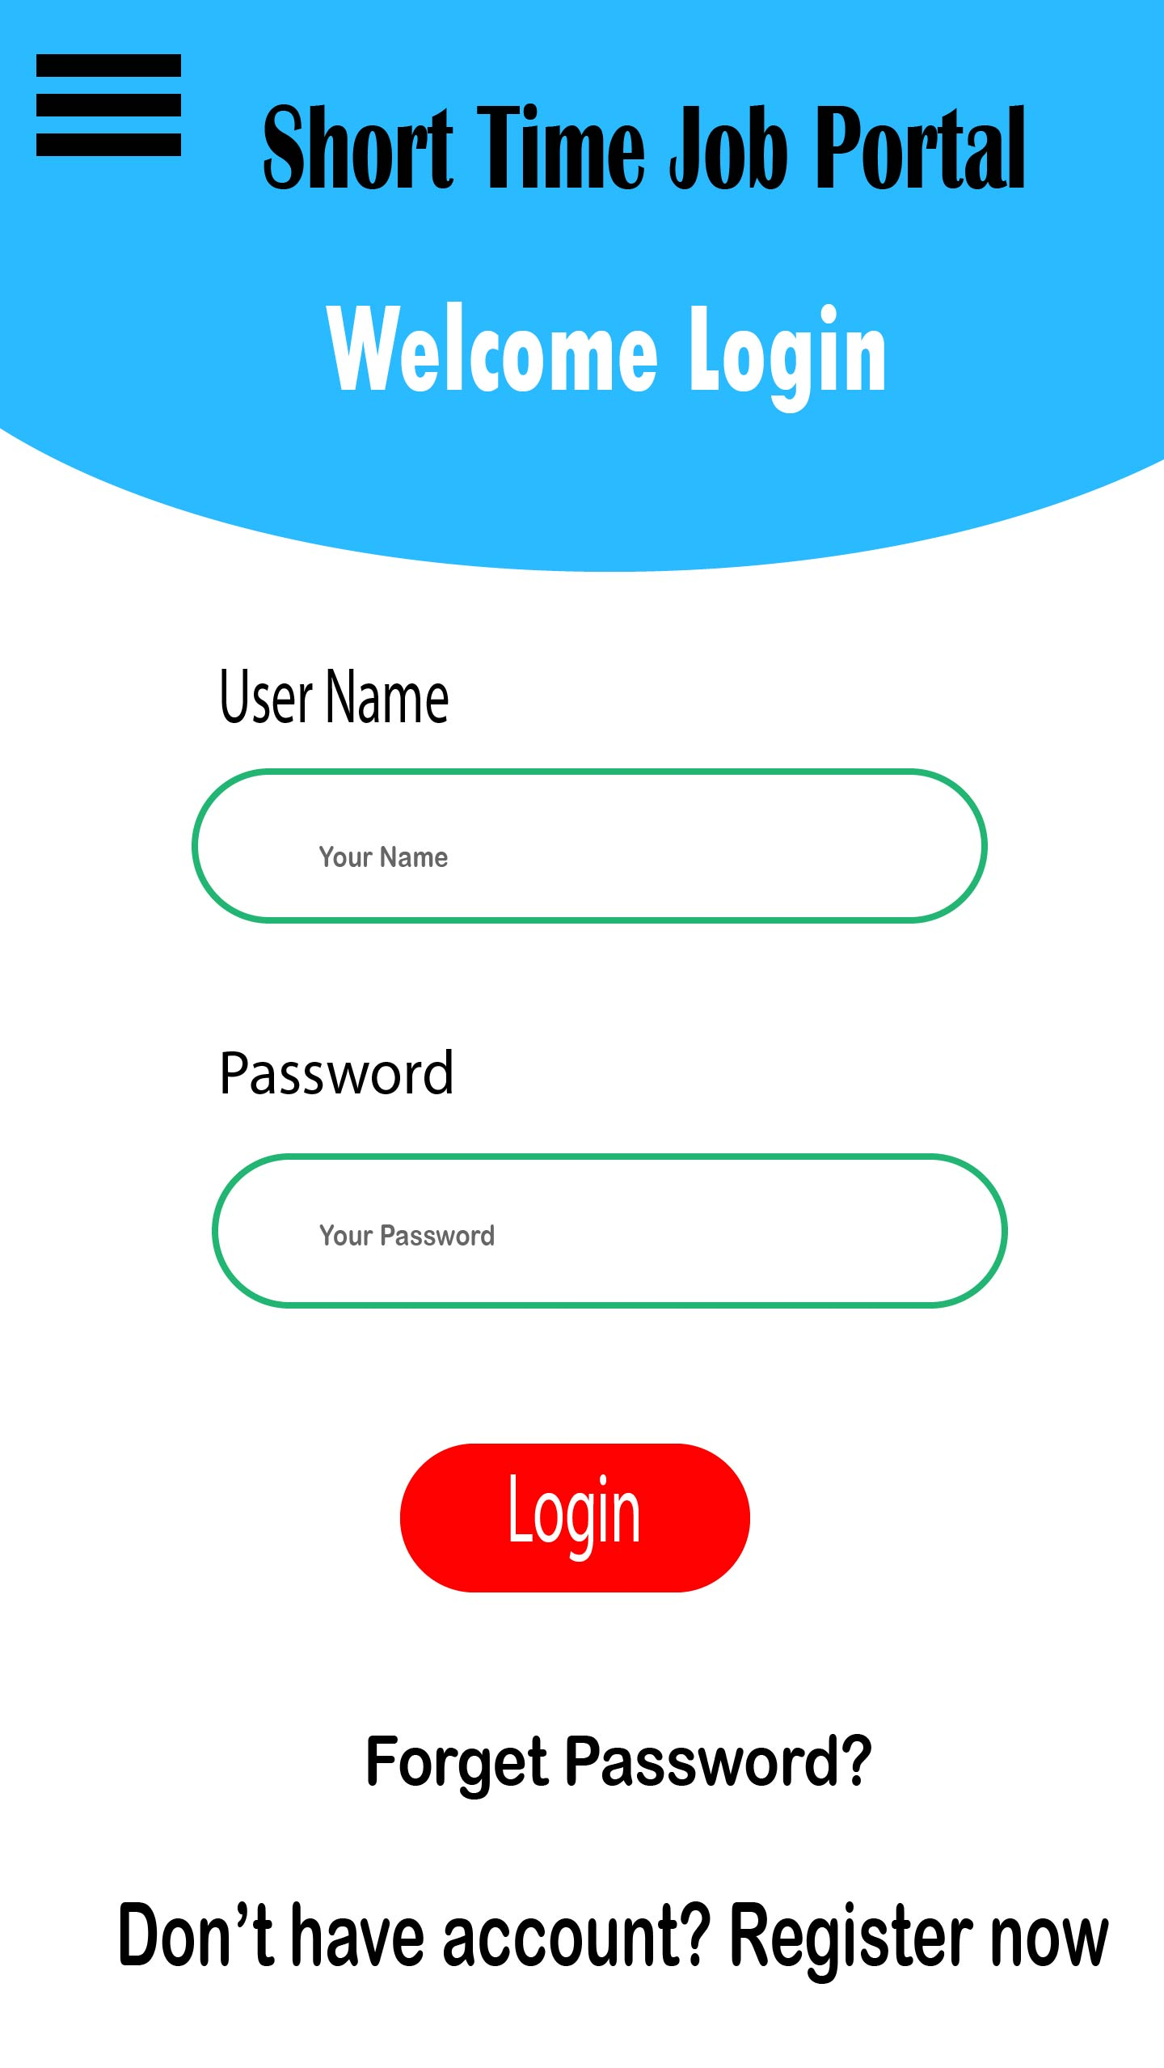

Slide 5
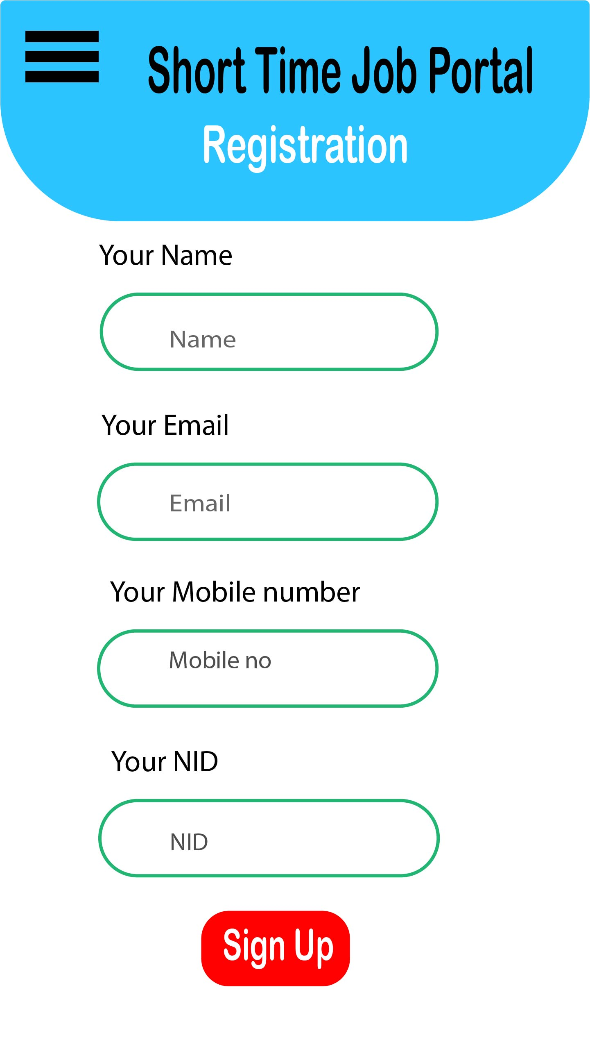

Slide 6
